Slide 1

PAC-MAN PROJECT Trần Đức Hải Triều ITITWE20027

Slide 2

Content
I. Gameplay
II. Code works
1. Creating map
2. The Pac-man
3. The ghosts
4. Check Maze
III. Final version

Slide 3
I. Gameplay:

Slide 4
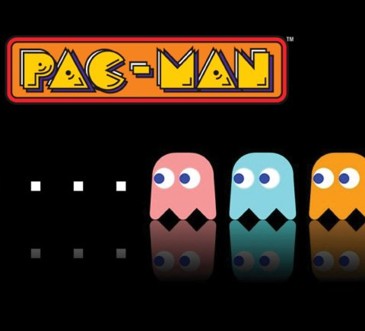
You will control the Pacman to eat all the white dots(points) on the map with avoiding the 2 ghosts wandering everywhere.
There’s 3 level for this game ( easy, normal and hard).

Slide 5
II. How the code works:

Slide 6
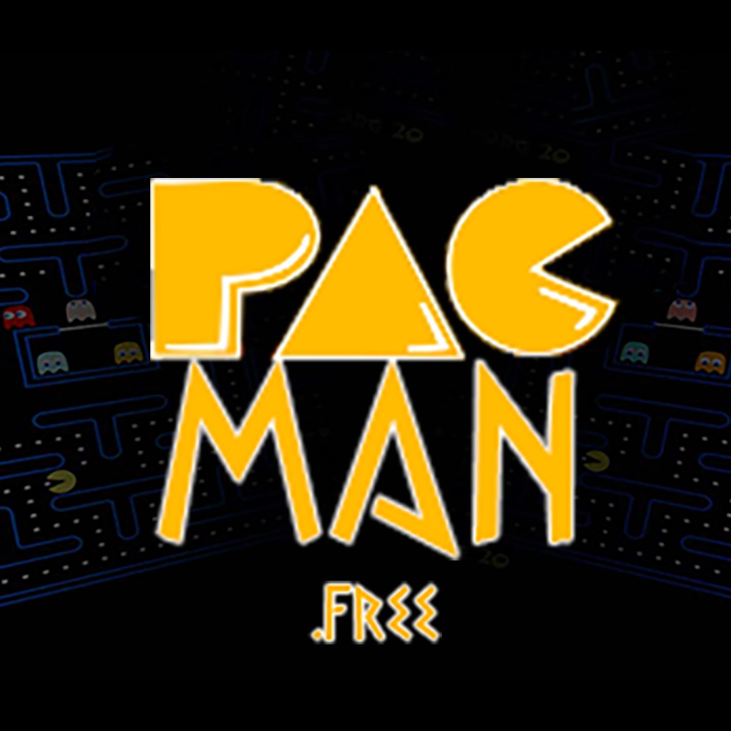
Code of this game has 3 main point we have to deal:
+Creating the map:
+The Pacman
+The ghosts

Slide 7
1.Creating the map

Slide 8
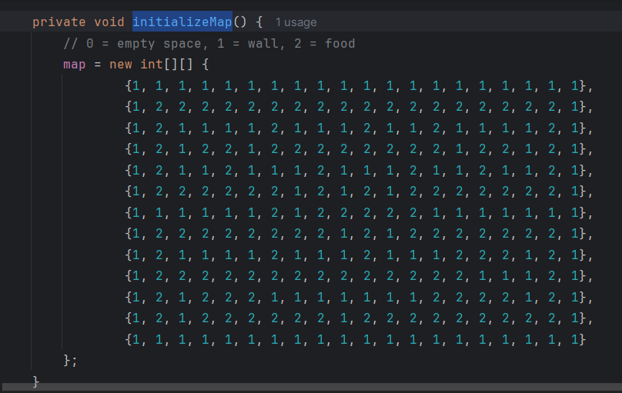
Like any other typical 8bit games, we based on the usual making of them. We have to create “initializeMap” including the numbers .
place them according to the rules:
1 = wall 2 = food 0 = tile without food ( after eaten )

Slide 9
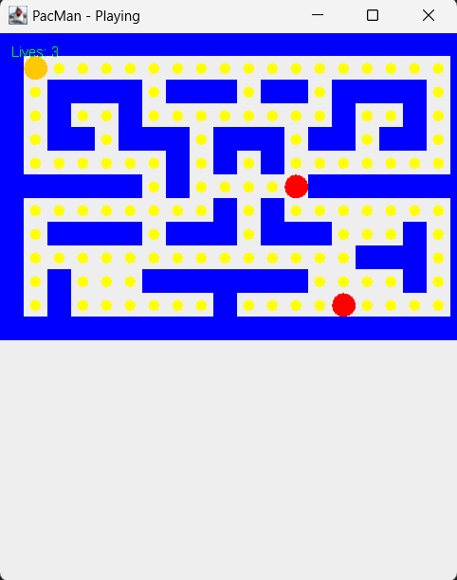
- You will be more clear about it according to this

Slide 10
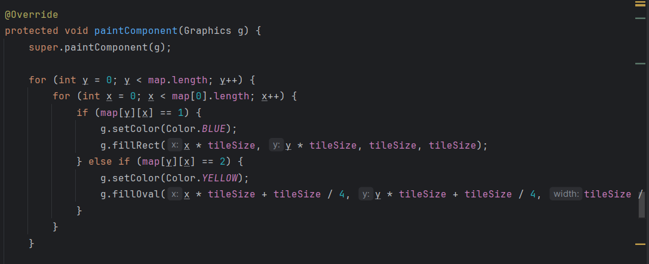
Via this, the method “paintcomponent” draws the map as we see:
+Two nested for loops iterate over the rows (y) and columns (x) of the map.
+For each position (x, y), the corresponding value in the map array determines what to draw.

Slide 11
2.The Pacman

Slide 12
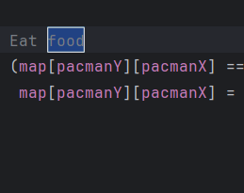
Pacman collects the white dots:
if (map[pacmanY][pacmanX] == 2) checks if the current tile
(map[pacmanY][pacmanX]) contains food.
map[pacmanY][pacmanX] = 0; removes the food by setting the tile to 0

Slide 13
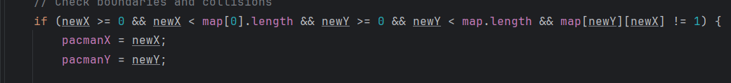
Making the Pacman standstill when touch the borders:
Boundary Check:
newX >= 0 && newX < map[0].length: Ensures Pac-Man's new horizontal position is within the grid's width.
newY >= 0 && newY < map.length: Ensures Pac-Man's new vertical position is within the grid's height.
Wall Collision Check:
map[newY][newX] != 1: Ensures the new position is not a wall (1 represents walls in the map).
If all these conditions are true, Pac-Man's position is updated:
pacmanX = newX;
pacmanY = newY;
When the Condition Fails:
If any condition is false (e.g., Pac-Man tries to move into a wall or out of bounds), the position remains unchanged. Pac-Man effectively "stands still."

Slide 14
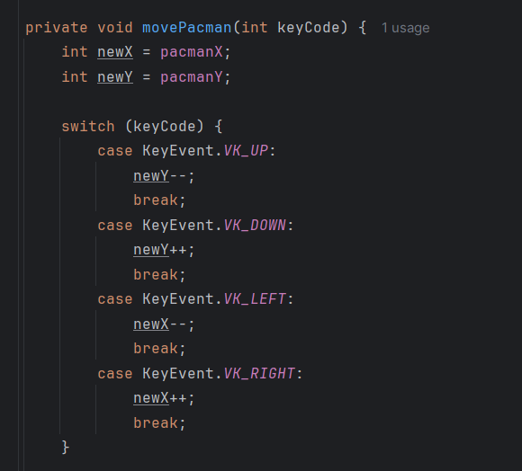
Making it moves:
The variables newX and newY are initialized to Pac-Man's current position (pacmanX, pacmanY).

Slide 15
3.The ghosts:

Slide 16
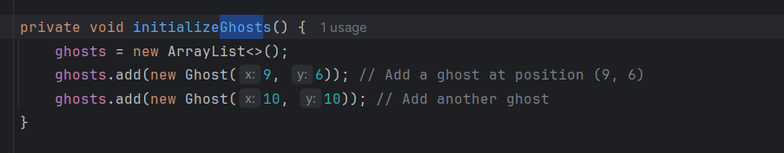
Spawn ghost at position of map
Iterating Over Ghosts:
The for loop goes through each ghost in the ghosts list.
Collision Detection:
The condition ghost.x == pacmanX && ghost.y == pacmanY checks if a ghost's position matches Pac-Man's position.
Action on Collision:
When a collision is detected:
lives--: Decreases the number of lives by one.
If lives == 0, the following happens:
A message box displays "Game Over!" using JOptionPane.showMessageDialog.
The game exits using System.exit(0).

Slide 17
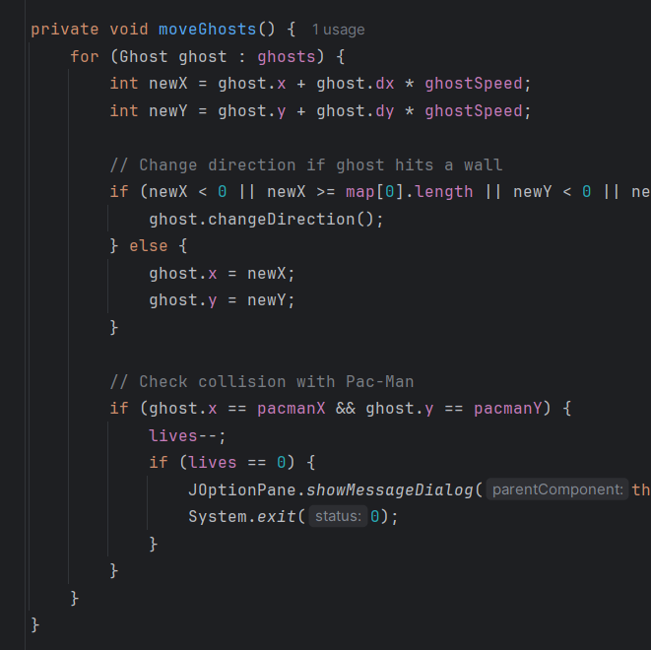
Move ghost to random place
Purpose of the Ghost Class:
The Ghost class defines the behavior and properties of each ghost, including its position and movement.
Attributes:
int x, y: The current position of the ghost on the grid.
int dx, dy: The direction of movement.
dx = -1 for left, dx = 1 for right.
dy = -1 for up, dy = 1 for down.
Both dx and dy can be 0, meaning no movement in that direction.
changeDirection Method:
Purpose: Randomly changes the direction of the ghost.
Implementation:
dx and dy are assigned random values between -1, 0, and 1 using Math.random().
This ensures the ghost can move up, down, left, right, or remain stationary in one direction.
Ensuring Continuous Movement:
The condition if (dx == 0 && dy == 0) ensures the ghost does not stop completely. If both directions are zero, dx is set to 1 (moves right).
How This Works in the Game:
Ghosts move in a grid-like pattern based on their dx and dy values.
If a ghost collides with a wall, it calls this method to choose a new direction

Slide 18
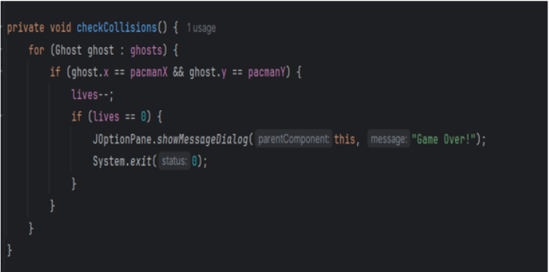
Ghost hit pacman
Purpose of the checkCollisions Method:
This method ensures the game handles interactions between Pac-Man and ghosts.
If a ghost occupies the same position as Pac-Man, Pac-Man loses a life.
Iterating Over Ghosts:
The for loop checks every ghost in the ghosts list.
Collision Detection:
The condition ghost.x == pacmanX && ghost.y == pacmanY ensures that a collision is detected if both the ghost’s and Pac-Man’s coordinates match.
Action on Collision:
Decrease Lives:
lives--; reduces Pac-Man's remaining lives by one.
Check for Game Over:
If lives reaches zero, the game ends:
A "Game Over!" message is shown using JOptionPane.showMessageDialog.
The program exits using System.exit(0).

Slide 19
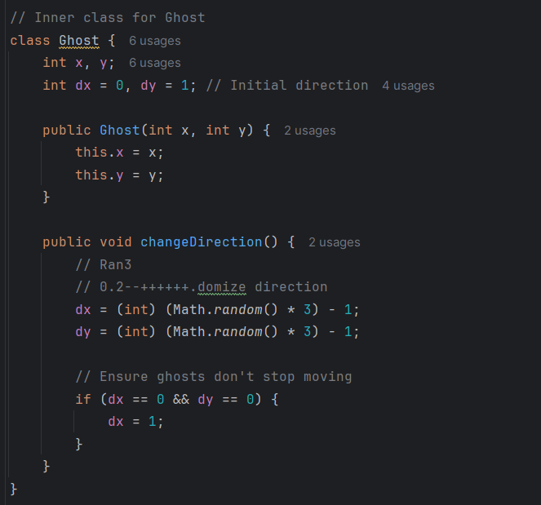
Random direction change and move continuously
Purpose:
Randomly assigns new directions to dx and dy using Math.random().
Random Direction Generation:
dx = (int)(Math.random() * 3) - 1: Generates values between -1, 0, and 1.
dy = (int)(Math.random() * 3) - 1: Similar random values for vertical direction.
Ensuring Movement:
If both dx and dy are 0 (stationary), dx is set to 1 to ensure the ghost keeps moving.

Slide 20

lll.Final version:
we plan to make the game will have different map after each round and add some different ghosts and portion.
Example : rage ghost will chase continuously if you in range heal portion will gain you 1 more life
.
}

Slide 21

The idea for heal portion:
// Eat food or collect potion
if (map[pacmanY][pacmanX] == 2) {
map[pacmanY][pacmanX] = 0;
} else if (map[pacmanY][pacmanX] == 3) {
map[pacmanY][pacmanX] = 0;
lives++; // Gain a life

Slide 22
The idea for rage ghost:
class Ghost {
int x, y; // Current position
int dx = 0, dy = 1; // Initial direction
private final int rageRange = 5; public void move(int pacmanX, int pacmanY) { // Calculate distance between ghost and Pac-Man
int distanceX = Math.abs(pacmanX - x); int distanceY = Math.abs(pacmanY - y)
// If within rage range, chase Pac-Man
if (distanceX <= rageRange && distanceY <= rageRange) {
chasePacman(pacmanX, pacmanY);
} else {// Otherwise, move randomly randomMove(); } }
private void chasePacman(int pacmanX, int pacmanY) { // Adjust direction to move toward Pac-Man
if (pacmanX > x) dx = 1; // Move right
else if (pacmanX < x) dx = -1; // Move left
else dx = 0; // No horizontal movement if (pacmanY > y) dy = 1; // Move down else if (pacmanY < y) dy = -1; // Move up else dy = 0; // No vertical movement }

Slide 23
IV. Thanks for listening

